Slide 1
Time Series Forecasting Techniques - Predict Hotel Demand

Slide 2

Agenda
Introduction and Business Objective
Time Series – Modelling
Model Used :
ARIMA
LSTM
Conclusion

Slide 3

The most important part of tourism is to manage hotels and resorts. The number of tourist flows in a Resort or hotel is the indicator of the hotel revenue. The accurate guest prediction to occupy all Rooms of the Hotel(ROH), is the key to revenue management that helps organizations and companies allocate limited tourism resources reasonably to maintain market competitiveness. The curve is non-linear with complex, huge, fluctuations in data and its characteristics. During the season the flow of tourists increases the demand in tourism management for the hotels and resorts. The decision-makers in tourism management fall into a dilemma, either overestimation or underestimation of the tourist flow. Forecasting accurately the results increases the demand. Tourism demands the overnight guests’ flow of hotels is complex non-linearity and fluctuations. This uncertainty during pick time or in a season creates a dilemma in the tourism department. Additionally, an online query index generated by the tourists creates traffic in searching for the proper information about the tourist flow. To introduce a proper Linear and non-linear method or frameworks that can survive the industry with meaningful and sharp growth in review.
Hotel Demand
Intro & Business Aspect

Slide 4




Time Series Models
MODEL USED
DATA SET
ARIMA:
Autoregressive
Autoregressive integrated moving average (ARIMA) models predict future values based on past values.
ARIMA makes use of lagged moving averages to smooth time series data.
They are widely used in technical analysis to forecast future security prices.
Autoregressive models implicitly assume that the future will resemble the past.
Therefore, they can prove inaccurate under certain market conditions, such as financial crises or periods of rapid technological change.
Moving Average
Incorporates the dependency between an observation and a residual error from a moving average model applied to lagged observations.
Main columns in data set:
Is_Cancelled
Leadtime
Arrival date
Stays_in_weekend

Slide 5
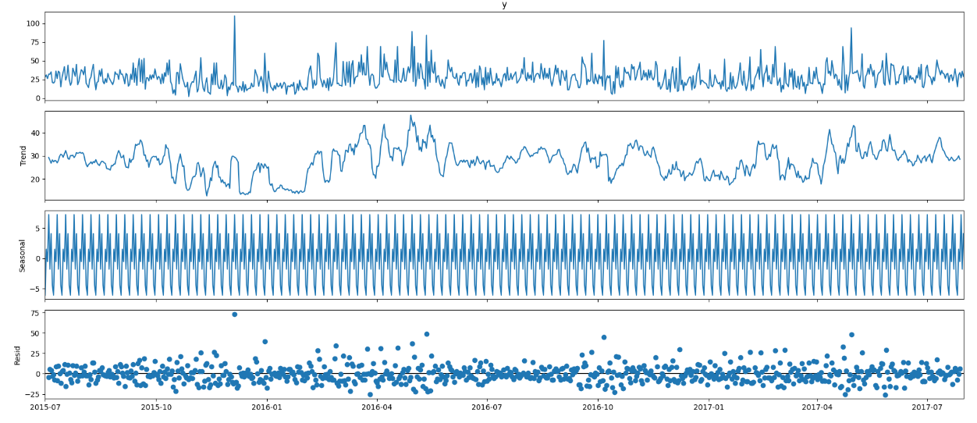
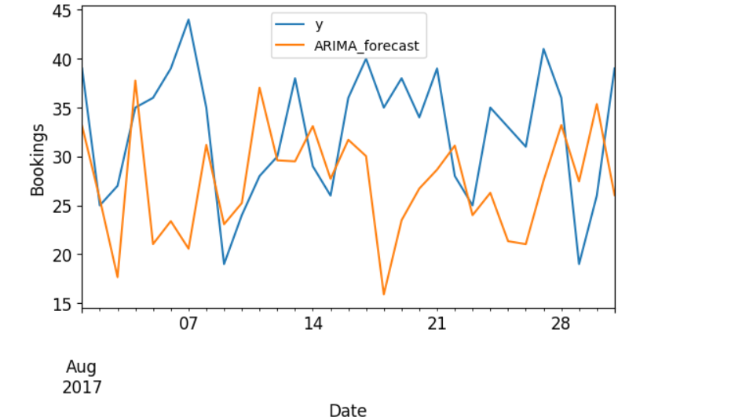
PERFORMANCE OF THE MODEL
OBSERVATIONS
The ARIMA(1,0,1)(2,1,0)[52] order to construct the ARIMA model,
leveraging its superior performance based on the AIC criterion.
***AIC -A statistical measurement of Information Criterion.

Slide 6
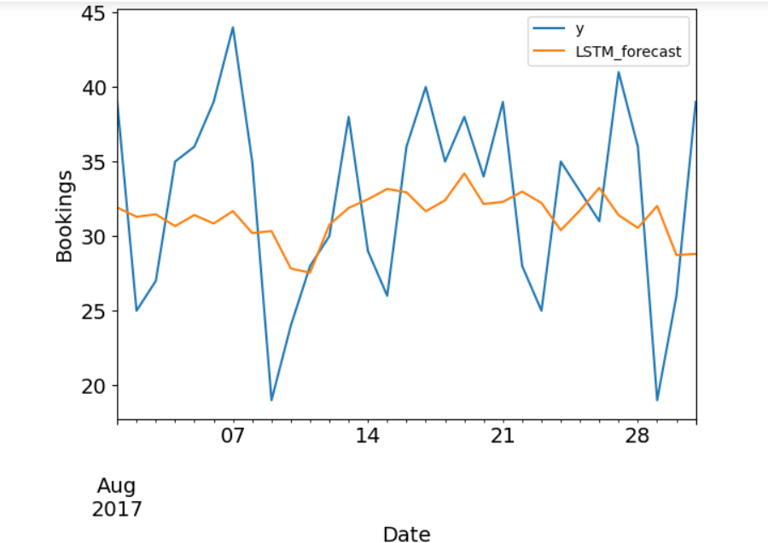
MODEL USED
PERFORMANCE OF THE MODEL
OBSERVATION
2. LSTM:
Long Short Term Memory, has an extreme ability to predict complex time series data.
It constructs an empirical analysis framework to forecast hotel accommodation demand.
It has been designed specifically to address the vanishing gradient specifically designed to address the vanishing gradient problem.
The memory cell that incorporates retains information over time, LSTM effectively captures the temporal dependency by employing 3 gates: (input, output & forget).
These gates control the data flow by remembering or forgetting past information.
Additionally, it updates information based on new input and allows LSTM to capture and leverage long-term dependencies in the data.
Based on data analysis, we can observe that LSTM achieves the lowest MAE i.e. 6, in contrast to ARIMA, i.e. 8, and can be considered the best method for our long-term forecasting task.

Slide 7
Conclusion
The ARIMA method works fine with linear data.
If the data is clean and has seasonality in it, then ARIMA is the best method.
But, if the data is non-linear and complex, LSTM is suitable.

Slide 8


Thank You
dSights is a data tech specialist with a vision to create value through:
Outcome-Oriented AI
Fueled by
Innovative Experimentation
Github : https://github.com/ds-stratgic-work/Time-Series-Forecast-on-Hotel-Demand.git

